Slide 1
Modern authentication and authorization
API Management

Slide 3
Module Overview
Intro to API Management
Developer portal access control
Policies & expressions
Security applications
Protecting the back-end API

Slide 4
OAuth 2.0 and OpenID Connect
Intro to API Management

Slide 5
Objectives
After completing this lesson, you will:
Understand the purpose of API Management (APIM)
Become familiar with the main components and user roles in APIM

Slide 6

Basic architecture
Publisher
Client
Developer
API developer
APIM
Client
application
Back-end API
User
Notes:
APIM on Azure is provided as a fully managed cloud service. It has 3 key components.
Publisher portal is used by API publishers, people who own the APIs, to manage the APIs. On the Publisher portal one can add and edit APIs, configure API policies, view analytics, etc. Metadata and settings entered on the Publisher portal drive both the gateway and the developer portal. Management operations can be automated by using a comprehensive but easy to learn and use API.
Developer portal is turn key and shows auto-generated API catalog, interactive documentation and samples. Its look-and-feel and behavior can be customized to reflect customer brand and needs.
Gateway acts as a front door and mediates all the requests to your APIs, collecting usage and health data and applying policies configured via Publisher portal. It can connect to backends located anywhere and implemented and running on any technology stack either directly or via VPN. Gateway supports both Basic HTTP and mutual certificate authentication.
Note that each user type is subject to different authentication/access control mechanisms.

Slide 7
Securing APIs
Task 1 only (takes >10 mins to deploy once started)

Slide 8
Why API management?
Establish a single “front door” to APIs for developers and client apps
Build API façades for existing backend services
Add new capabilities to the APIs e.g. response caching
Ramp-up developers with docs, samples, and API console
Gain insights into usage and health of APIs
Monitor, alert, and troubleshoot APIs
Secure and protect published APIs from abuse and overuse

Slide 9
APIM Terminology
Publisher: decides what and how to publish and who can use it
Front-/back-end API : what client developers use/what is called by APIM
Client Developer: decides which APIs to use in an application
Product : Collection of API endpoints, defines usage quota and terms of use
Operation : specific HTTP operation available to developers

Slide 10
Establishing an APIM service
Create APIM service through Azure portal
Add a product
Notes:
Note: it may take a few minutes to create a new APIM service. Rather, create it earlier and here just show how to initiate the creation process.

Slide 11
OAuth 2.0 and OpenID Connect
Developer portal

Slide 12
Objectives
After completing this lesson, you will:
Understand access controls provided in APIM
Become familiar with the purpose and use of the APIM developer portal

Slide 13
Access control
Publisher: Azure subscription AAD; Azure RBAC
Developer: determined by publisher, includes AAD, FB, MSA; support for AAD and custom groups
Application: determined by publisher and/or back-end API
Note: subscription key is NOT a way to secure your APIs: it is shared by all users of a client app and can be easily discovered!
Notes:
Frequent source of confusion: developer access to portal has nothing to do with application’s access to the API. API has to define its own scheme (e.g. Oauth) for authorizing users, whether or not it is using APIM.

Slide 14
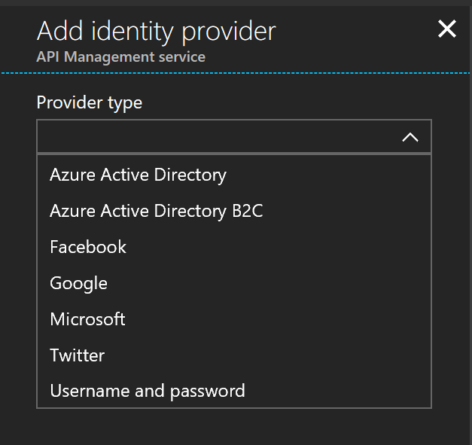
Developer portal access security
Access control to the developer portal
Local Username/Password by default
Supports on-boarding process
New user sign-up & legal terms
Note: unrelated to how the back-end API is secured!
Other identity providers supported (depending on pricing tier)
Notes:
Azure AD supported on Developer, Standard, Premium
Azure AD B2C only supported in Developer, Premium

Slide 15
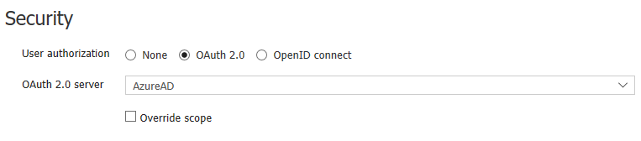
Token services for API evaluation
Applies to Developer Portal only
Good for testing APIs and policies
Allows Developer Portal to request an appropriate token before calling the backend API
Does NOT secure the back-end API – that requires API developer work
2 parts:
Configure the OAuth 2.0 / OpenID Connect authorization server
Configure the API settings

Slide 16
Developer token configuration
Notes:
Use Seurity -> OpenID or Oauth and configure to use AAD
Show what it then looks like in the Developer Portal – Authorization options when testing an API.

Slide 17
OAuth 2.0 and OpenID Connect
Policy and expressions

Slide 18
Objectives
After completing this lesson, you will:
The roles of policies and expressions in API
Become familiar with expression syntax

Slide 19
Policies
Define what APIM does to API requests and/or responses
May change both the content and destination of an operation
Accessible through the Azure or Publisher portal
Can be defined globally, per product, per API or operation
Uses declarative XML, C#-type expressions and properties

Slide 20
Defining a policy
Show APIs
Start defining a scoped policy
Show list of policies

Slide 21
Policy example
<cors allow-credentials="false|true">
<allowed-origins>
<origin>origin uri</origin>
</allowed-origins>
<allowed-methods preflight-result-max-age="number of seconds">
<method>http verb</method>
</allowed-methods>
<allowed-headers>
<header>header name</header>
</allowed-headers>
<expose-headers>
<header>header name</header>
</expose-headers>
</cors>

Slide 22
Expressions
Used to dynamically configure policies
C# “snippets” embedded in policies using Razor syntax
Read-only access to the request context
Access to whitelisted .NET types
@{
string value;
if(context.Request.Headers.TryGetValue(
"Authorization", out value))
{
return Encoding.UTF8.GetString(
Convert.FromBase64String(value));
} else
{
return null;
}
}

Slide 23
Properties
Collection of name/value pairs associated with an APIM instance
Properties may be defined as ‘secret’ and thus encrypted
Value may be a literal or a Policy Expression
Referenced using ‘{{‘ notation
<set-header name="{{ContosoHeader}}" exists-action="override">
<value>{{ContosoHeaderValue}}</value>
</set-header>

Slide 24
Properties
Show Named values tab in the portal

Slide 25
OAuth 2.0 and OpenID Connect
Uses of APIM for API security

Slide 26
Objectives
After completing this lesson, you will:
Be able to enumerate APIM features used for security
Understand the options in using these features

Slide 27
Security related features of APIM
Frontend (client to APIM)
Token validation
Backend (APIM to back-end)
Back-end certificate authentication
Request rate throttling
Source IP restrictions
Authentication scheme conversion/augmentation
Stripping response headers
Client certificate authentication
Connect to back-end via protected network
Transaction tracing
Back-end Basic Authentication
Notes:
E.g. of headers you may want to strip: X-AspNet-Version.

Slide 28
Client to APIM certificate authentication
Check for presence
Expiration date
Issuer and subject
Thumbprint
<choose>
<when condition="@(context.Request.Certificate == null || context.Request.Certificate.NotAfter < DateTime.Now)" >
<return-response>
<set-status code="403" reason="Invalid client certificate" />
</return-response>
</when>
</choose

Slide 29
Throttling: rate limit by subscription
<policies>
<inbound>
<base />
<rate-limit calls="20" renewal-period="90" />
</inbound>
<outbound>
<base />
</outbound>
</policies>
Notes:
https://docs.microsoft.com/en-us/azure/api-management/api-management-access-restriction-policies#LimitCallRateByKey
Times are in seconds

Slide 30
Throttling: rate limit by counter key
<policies>
<inbound>
<base />
<rate-limit-by-key calls="10"
renewal-period="60"
increment-condition="@(context.Response.StatusCode == 200)"
counter-key="@(context.Request.IpAddress)"/>
</inbound>
<outbound>
<base />
</outbound>
</policies>

Slide 31
JWT token validation
<inbound>
<validate-jwt header-name="Authorization" failed-validation-httpcode="401">
<openid-config url="https://login.microsoftonline.com/meraridom.com/.well-known/openid-configuration" />
<audiences>
<audience>https://test.resource.net</audience>
</audiences>
</validate-jwt>
</inbound>
Also possible with specified signing keys (no metadata) and B2C tokens

Slide 32
Caller IP address restrictions
<inbound>
<ip-filter action="allow | forbid">
<address>address</address>
<address-range from="address" to="address" />
</ip-filter>
</inbound>

Slide 33
Removing headers
<outbound>
<base />
<set-header name="X-Powered-By" exists-action="delete" />
<set-header name="X-AspNet-Version" exists-action="delete" />
</outbound>

Slide 34
OAuth 2.0 and OpenID Connect
Protecting the back-end

Slide 35
Objectives
After completing this lesson, you will:
Understand how to secure back-end access from APIM

Slide 36
Protecting access to back-end API
Pass all
Pre-validate (e.g. JWT) but then pass to back-end
Use client certificate authentication
Deploy APIM as front-end to private network
Deploy APIM to inside a private network
Use Azure Application Gateway to expose internally-deployed APIM
Notes:
https://docs.microsoft.com/en-us/azure/api-management/api-management-howto-mutual-certificates

Slide 37
Using private network
Provides network-level protection of back-end API
APIM may be deployed inside virtual network (VNET)
Back-end services are accessible only to the APIM service
Front-end API may be configured inside or outside network
Controls who can access the API
Notes:
https://docs.microsoft.com/en-us/azure/api-management/api-management-using-with-vnet

Slide 38
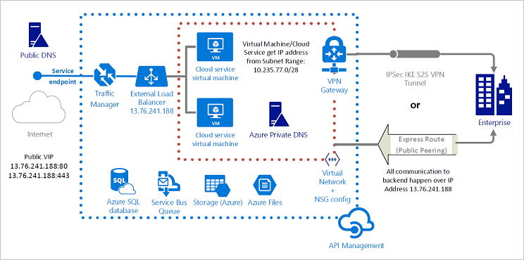
APIM with public access

Slide 39
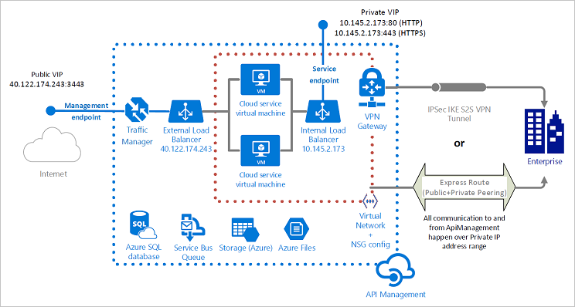
APIM with private access

Slide 40
Basics of API Management
Use of policies and expressions
Use of policies for API security
Back-end access control

